Slide 1
Reversal New Highs

Slide 2
Reversal New Highs Pattern (For Longs)
Must be an outside day
Must be 60 day high
Must have largest range of the past 5 days
Buy at tomorrow’s open
Use a trailing stop for exit point
Reversed for shorts

Slide 3
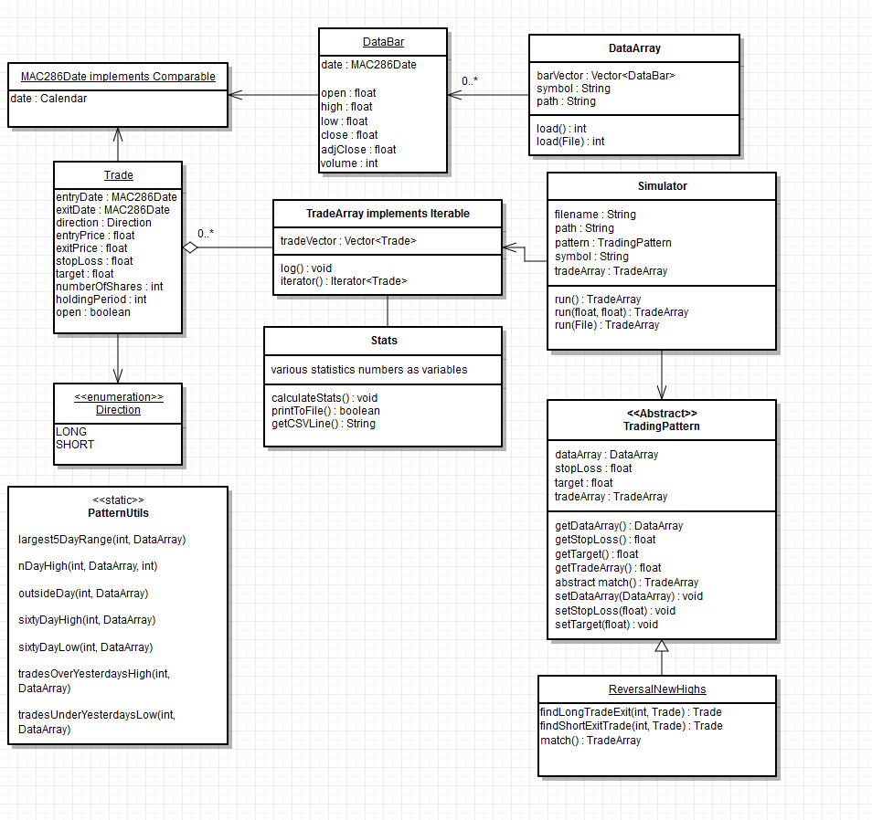

Slide 4
Insert Flow Chart for BigMain Here

Slide 5
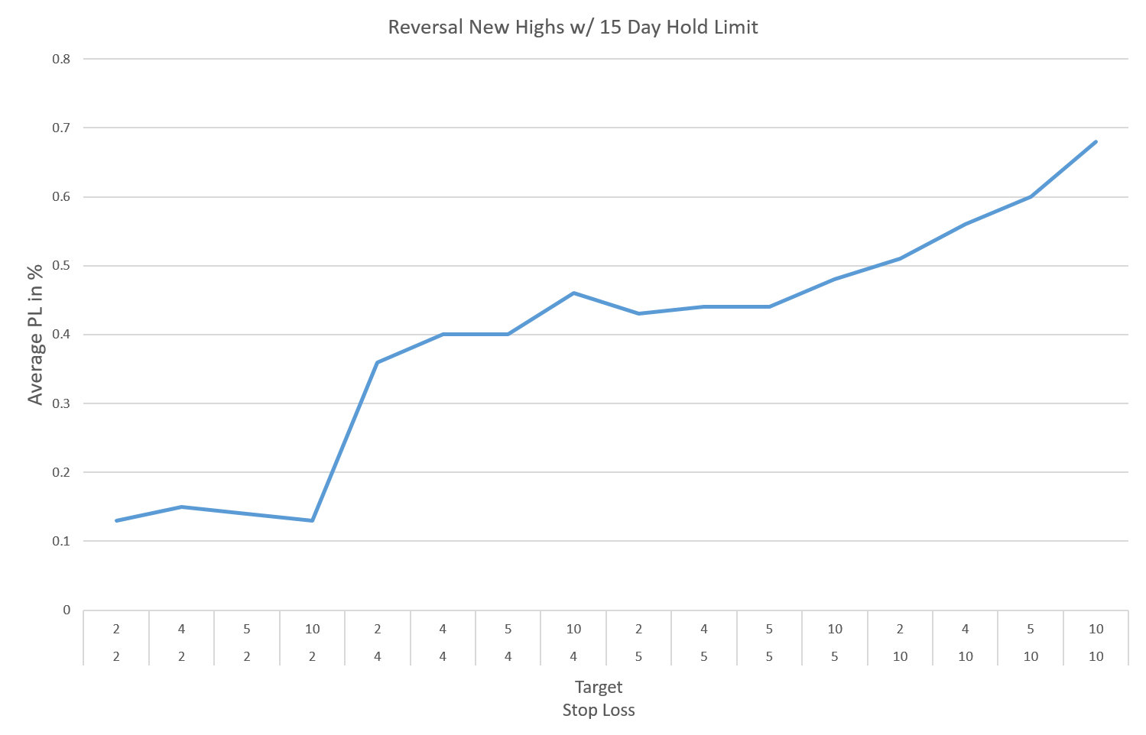

Slide 7
